Slide 1


Automated Capacity Planning Analysis
Nanulescu Alexandru-Nichita
Toma Bianca

Slide 2


Introduction
The Automated Schedule Difference Reporter is a Python utility designed to compare planned work capacity against actual hours logged. It processes two input Excel files: one detailing planned resource allocations and another containing actual time entries and generates a consolidated Excel report showing the differences. This tool assists in tracking adherence to schedules and identifying variances in resource utilization.

Slide 3





Used tools
Programming
Data visualization & presentation
Python
Pycharm
GitHub
Excel
Power BI
Powerpoint

Slide 4
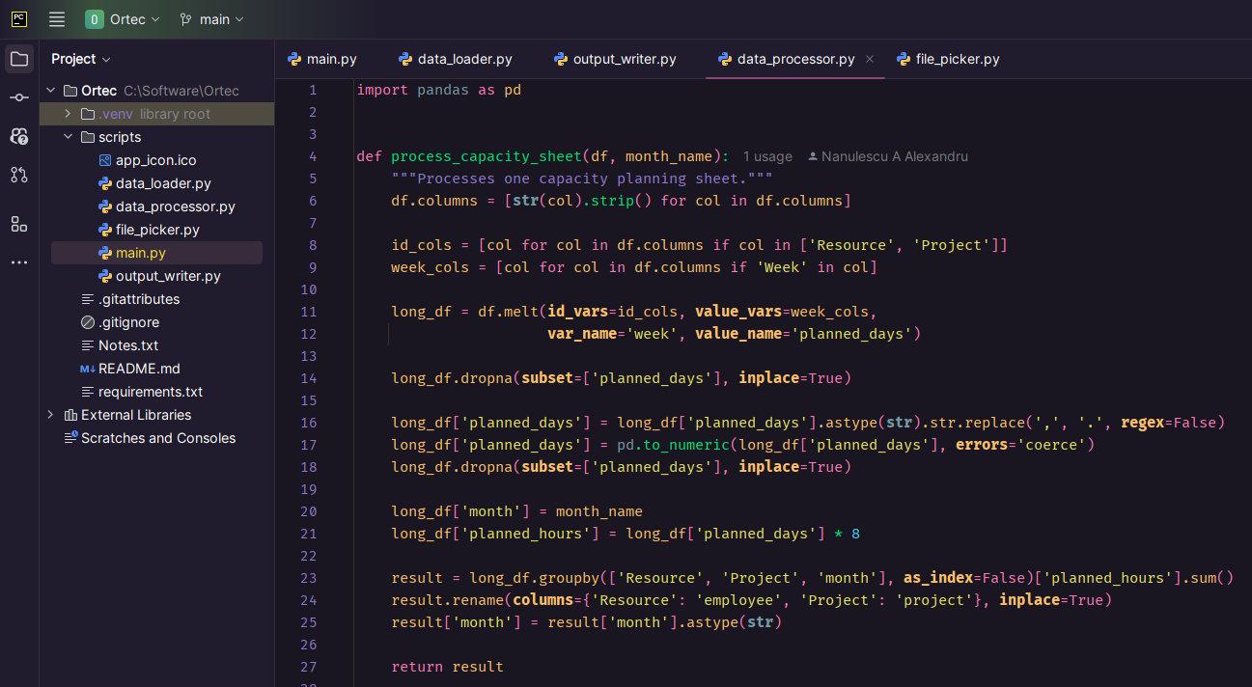
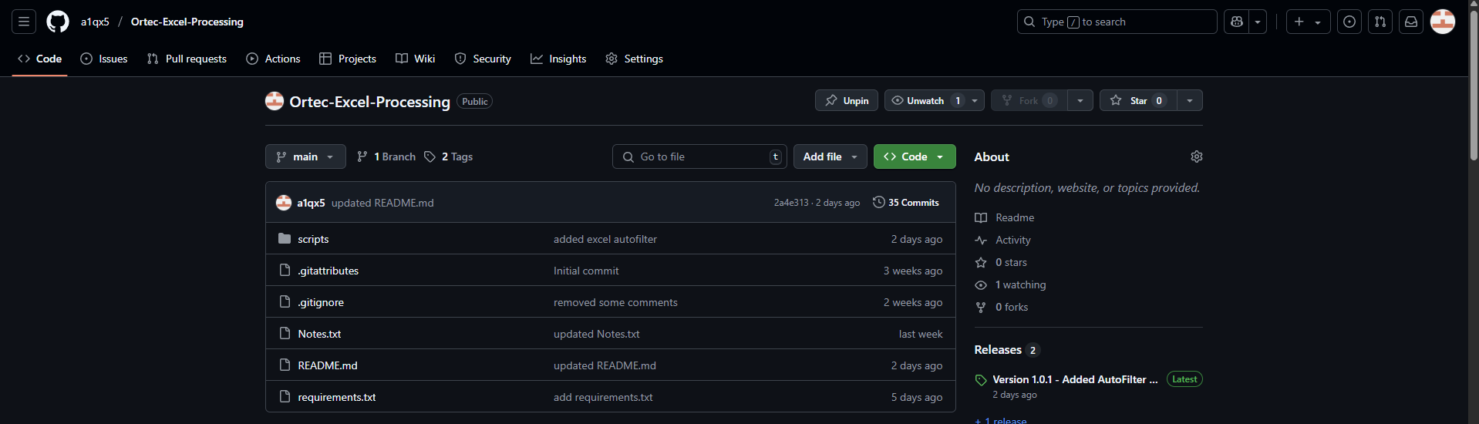
Development process: Programming

Slide 5
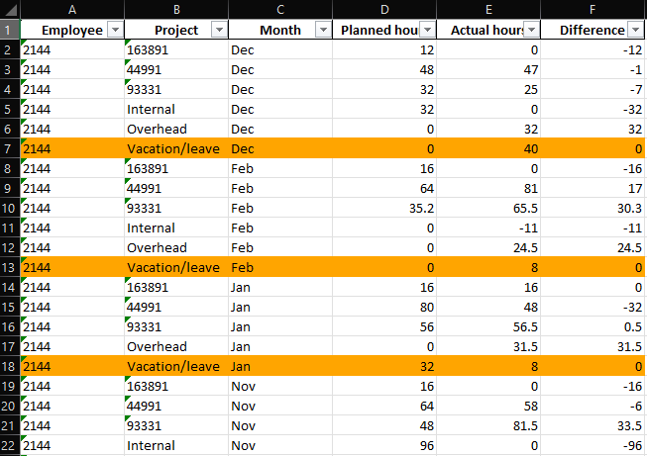
Program output

Slide 6
Live Demonstration of the tool
Download app: https://github.com/a1qx5/Ortec-Excel-Processing/releases/tag/v1.1.0
Download Excel files: https://github.com/a1qx5/Ortec-Excel-Processing/tree/main/input%20excels

Slide 7
Development process: Data visualization
DAX
Statistics
Graphical representations

Slide 8
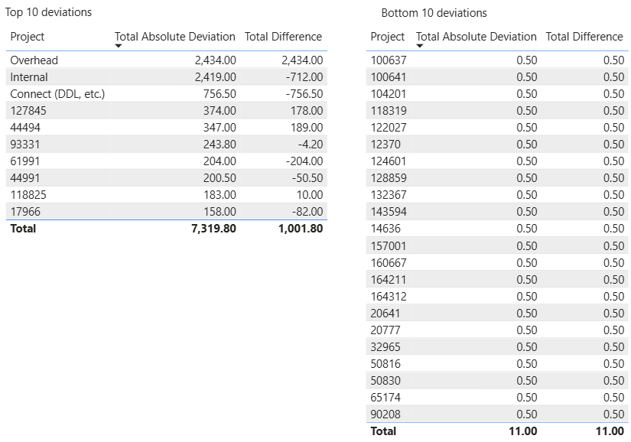
KPI’s & metrics
Top and Bottom 10 projects with highest deviations.

Slide 9
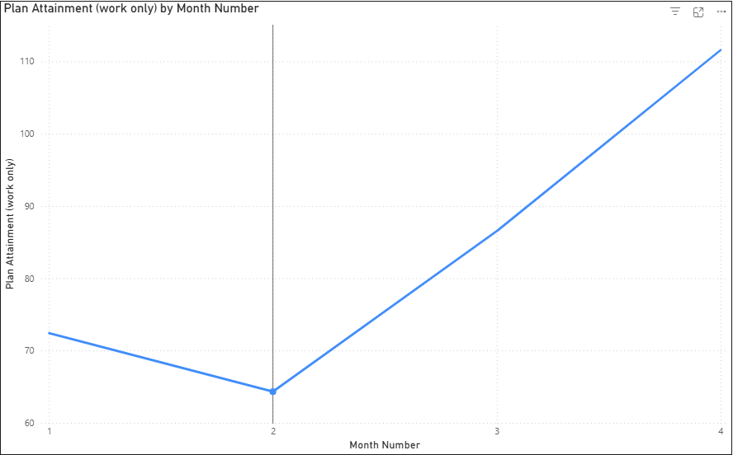
KPI’s & metrics
February had the highest Plan Attainment at 111.57%, followed by January, November, and December.﻿﻿ ﻿﻿ ﻿﻿Across all 4 months, Plan Attainment ranged from 64.31% to 111.57%.﻿
Notes:
100% - perfection
Plan attainment = total actual hours / total planned hours

Slide 10
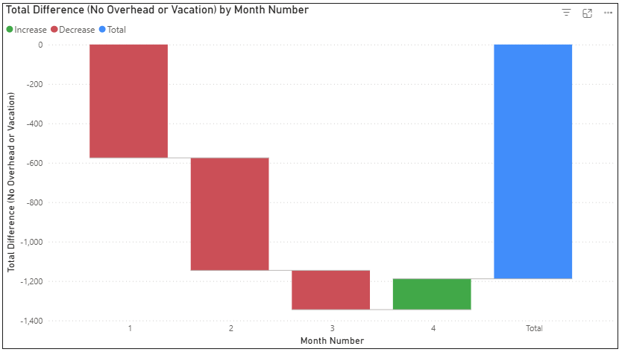
KPI’s & metrics
November had a negative difference of 575 hours. The differences in December & January remain negative with a small positive in February, summing up to a total difference of -1188.70 hours.
Notes:
Waterfall chart

Slide 11
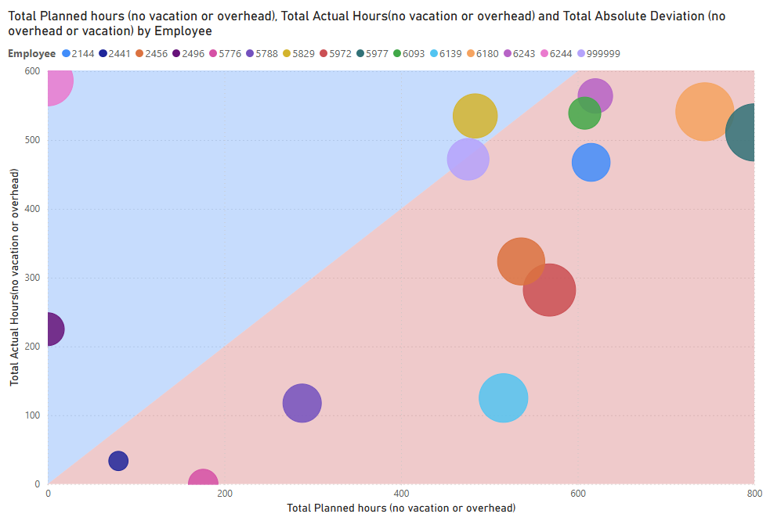
KPI’s & metrics
﻿Employee 5977 had the highest Total Planned hours (800) and employee 6244 had the highest Total Realized Hours (586.50).
Size of the bubbles scales with﻿﻿﻿﻿ ﻿the total absolute deviation.
Notes:
Scatter diagram
Blue hemisphere – employees worked more than planned
Red hemisphere – employees worked less than planned

Slide 12
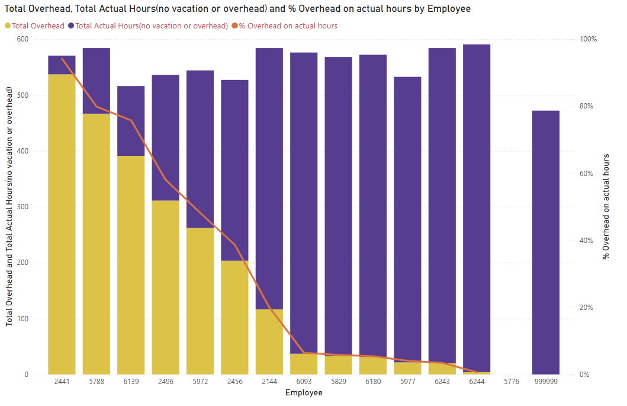
KPI’s & metrics
Across all 15 Employees, Total Overhead ranged from 4 hours to 537 hours, Total Realized Hours (no vacation or overhead) ranged from 0 to 586.50, and % Overhead on Actual Hours ranged from 0.68% to 94.13%.

Slide 13

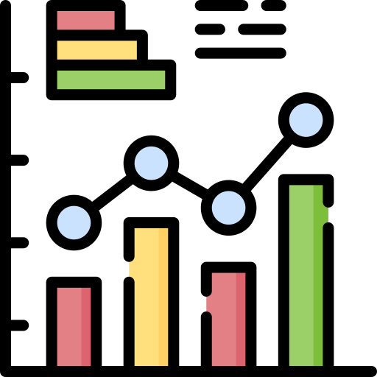



Challenges
Programming
Data visualization
Code errors / random crashes
Learning Pandas python library
Automatization
DAX & measures
Which visual is the most appropriate?

Slide 14
Feedback

Slide 15


